Slide 1
CityU CSHK PASS SYMPOSIUM Global Connectivity, Opportunities and Challenges: Hong Kong and ETCZs along Belt & Road Opportunities For The Accountancy Industry
Speaker: Johnson Kong – Immediate Past President
Date: 7 January 2021
Notes:
Speaker notes:

Slide 2
Contents
1. Hong Kong Institute of Certified Public Accountants
2. Hong Kong Advantages
3. Opportunities for Accountancy Industry
4. Challenges & Risks

Slide 3
Hong Kong Institute of Certified Public Accountants
Established on 1 January 1973 under the Professional Accountants Ordinance
Only body authorized by law to register and grant practising certificates to CPAs in Hong Kong
Salient Roles:
Qualification and licensing of accountants
Standard setting
Regulate the conduct of members
Member support and development
Total number of member: 46,433
Total number of students: 18,152
Total number of CPA practices: 1,926
Member of IFAC
(Figures as at 30 November 2020)

Slide 4
Hong Kong Advantages
Proximity to Mainland China
Internationality
Connectivity to Asia and Beyond
Quality and Diversity of Services
Synergy
Efficiency and Flexibility
Notes:
Speaker notes:

Slide 5
Opportunities for Accountancy Industry
Audit and Assurance
Business Valuation
Consultancy
Corporate Intelligence
Corporate Services
Financial Advisory
Financial Due Diligence
Fund Raising
Human Capital Advisory
Market Entry Strategies Analysis
Merger & Acquisition Consulting
Risk Management
Tax Advisory
Notes:
Speaker notes:

Slide 6
Challenges & Risks
Mindset
Building a Platform
Small & Medium CPA Practices – Limitations
Political, Economic and Cultural Considerations
ETCZs
Notes:
Speaker notes:

Slide 7
Thank You

Slide 8
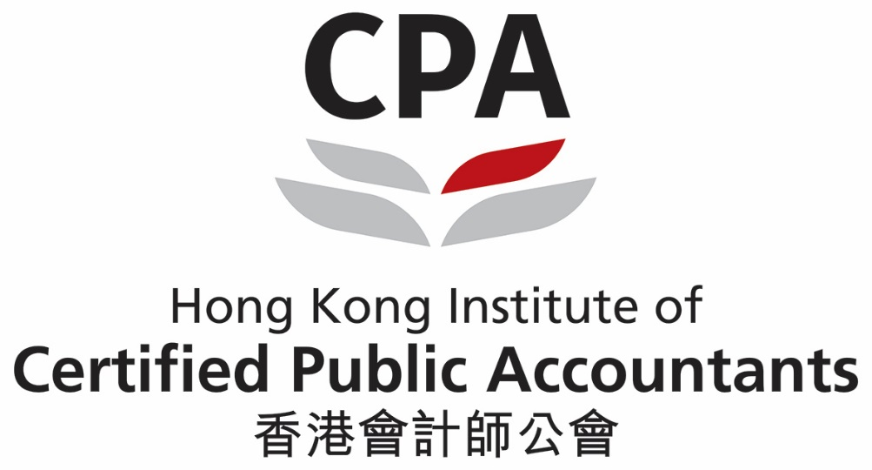
Notes:
Speaker notes:

