Slide 1
John Yung
The Shanghai Commercial & Savings Bank
Board Member, SEVP & CIO
Portfolio: IT, Risk, Compliance, Legal, Operations, International Business Development and The Three Shanghai Banks Alliance
Shanghai Commercial Bank
Board Member & Audit Committee
AMK Microfinance Ltd
Board Member, Audit & Social Performance Committee, Shareholder Representative

Slide 2
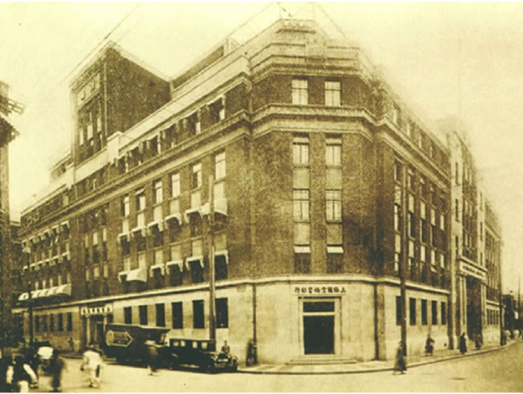
Introduction of SCSB Group
Establish in 1915, Shanghai, China by renown banker Mr. KP Chen with a social mission
Mr KP Chen believes for China to be strong, a strong middle class and SME as it’s economic foundation
SCSB is one of the first bank in China to serve the unbanked with modern banking services
SCSB introduce innovation products, saving with one Yuen, Microfinance, remittances, trade finance, founding of China Travel Services, etc

Slide 3
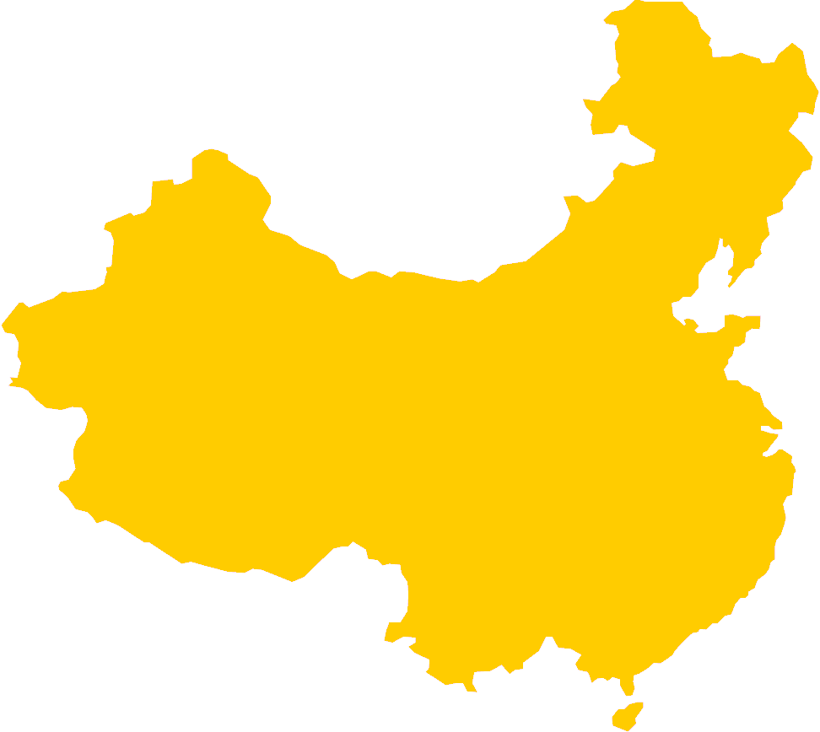
Three Shanghai Banks Alliance
Keelung
Taipei
Taoyuan
Hsinchu
Yilan
Taichung
Bank of Shanghai
Yuanlin
Tainan
The Shanghai Commercial & Savings Bank, Ltd.
Beijing
Kaohsiung
Pingtung
Tianjin
Suzhou
Nanjing
Shanghai
Chengdu
Ningbo
New Territories
Hangzhou
Kowloon
Shenzhen
Taiwan
Hong Kong
Island
Hong Kong
Shanghai Commercial Bank

Slide 4
Mainland China Partner
Area | Branch
Local | 315
Subsidiary in Overseas | 1
Subsidiary in China | 4
London
San Francisco
New York
Shanghai
Taiwan Hometown
Los Angeles
Shenzhen
Area | Branch
Local | 72
Overseas | 3
Rep Office | 3
Hong Kong Branch.
Vietnam
Don-Nai Branch
Thailand Bangkok Rep
Hong Kong
Subsidiary
Cambodia Phnom Penh Rep
AMK Microfinance
Area | Branch
Local | 44
Overseas | 4
China | 3
Cambodia
Subsidiary
Area | Branch
Local | 149
Singapore Branch
Indonesia Jakarta Rep

Slide 5
Why Cambodia?
The rich history, The people, The suffering, The resilience
For financial institutions, a forward thinking and efficient regulator
Popular investment designation and a major part of “One Belt One Road”

Slide 6
Why AMK Microfinance?
History of AMK goes back to early 1990’s as a NGO and over the years successfully transform into a systemically important financial institution for the rural poor
Committed management and employees to AMK Mission
Similar history and mission as SCSB

Slide 7
SCSB Mission
AMK Mission
"to help large numbers of poor people to improve their livelihood options through the delivery of appropriate and viable microfinance services”.
Notes:
The smart art is refer to Social Performance Framework where AMK measure 5 mains pillars

Slide 8
AMK measure our mission through this 5 dimension under the SPM framework
Depth of Outreach
Adequate Products
Transparency & Client Protection
Other CSR
Impact on Clients
Notes:
The smart art is refer to Social Performance Framework where AMK measure 5 mains pillars

Slide 9
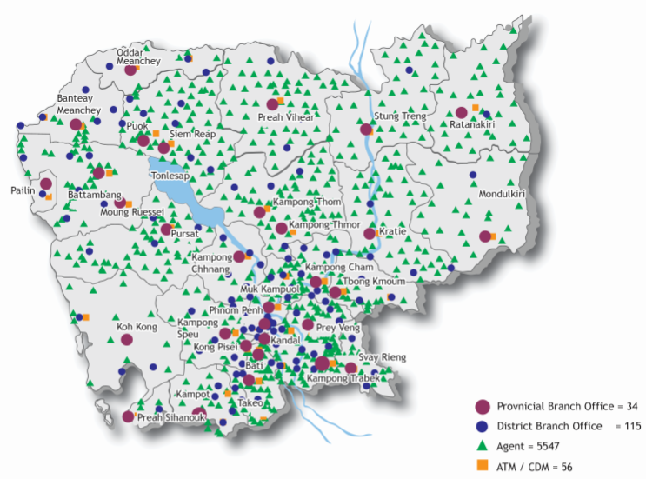
AMK covers 91% of total villages in Cambodia

Slide 10
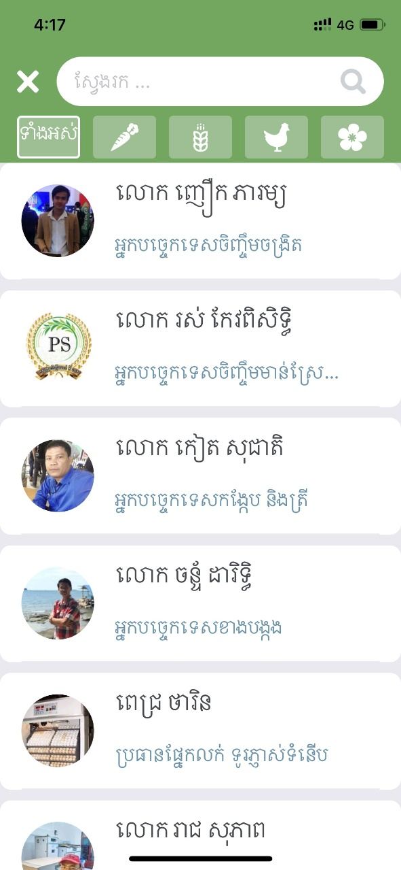
Technical Guide
Market place
Experts

Slide 11
How can we help?
Sharing of local knowledge to help with strategic planning
Current economic trends
Tax, audit, legal, investment advisory
Incentive and regulation in different industry
Human Resources and local culture
Global Banking Service
Utilizing SCSB global network
Local Banking Service
Remittance, payments, payroll, local employee benefits, supply chain
finance, open banking api

